Slide 1
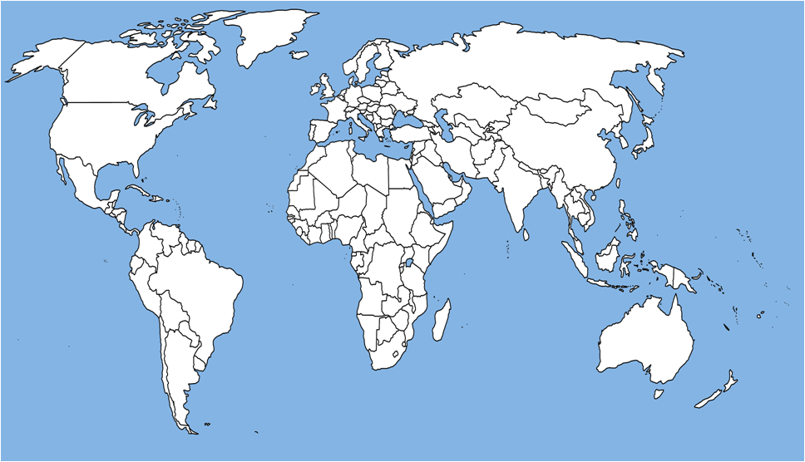
Minimum-Area Drawings
of Plane 3-Trees
Debajyoti Mondal, Rahnuma Islam Nishat,
Md. Saidur Rahman and Md. Jawaherul Alam
Graph Drawing and Information Visualization Laboratory
Department of Computer Science and Engineering
Bangladesh University of Engineering and Technology (BUET)
Dhaka – 1000, Bangladesh
CCCG 2010
August 11, 2010

Slide 2
Minimum-Area Drawings
A Plane Graph G
A Straight-Line Drawing of G
H = 5
H = 4
W = 8
W = 6
A Straight-Line
Grid-Drawing of G
on 8×5 grid
A Straight-Line
Grid-Drawing of G
on 6×4 grid
CCCG 2010
2
August 11, 2010

Slide 3
Minimum-Area Drawings
H = 5
H = 6
A Plane Graph G
A Straight-Line Drawing of G
W = 7
W = 6
H = 5
H = 4
H = 4
H = 5
W = 8
W = 6
W = 6
A Minimum-Area
Drawing of G
A Straight-Line
Grid-Drawing of G
on 8×5 grid
A Straight-Line
Grid-Drawing of G
on 6×4 grid
W = 8
CCCG 2010
3
August 11, 2010

Slide 4
Previous Results
de Fraysseix et al. [1990] | Straight- line grid-drawing of plane graphs with n vertices | (2n−4)×(n−2)
Schnyder [1990] | Straight- line grid-drawing of plane graphs with n vertices | (n−2)×(n−2)
Brandenburg [2004] | Straight- line grid-drawing of plane graphs with n vertices | (^{4n}/₃) × (^{2n}/₃)
Krug and Wagner [2008] | Whether a planar graph has a drawing on a given area | NP-Complete
This Presentation | Whether a ‘plane 3-tree’ has a drawing on a given area | P
CCCG 2010
4
August 11, 2010

Slide 5
Previous Results
Our Result
We obtain minimum-area drawings for
plane 3-trees in polynomial time
de Fraysseix et al. [1990] | Straight- line grid-drawing of plane graphs with n vertices | (2n−4)×(n−2)
Schnyder [1990] | Straight- line grid-drawing of plane graphs with n vertices | (n−2)×(n−2)
Brandenburg [2004] | Straight- line grid-drawing of plane graphs with n vertices | (^{4n}/₃) × (^{2n}/₃)
Krug and Wagner [2008] | Whether a plane graph has a drawing on a given area | NP-Complete
This Presentation | Whether a ‘plane 3-tree’ has a drawing on a given area | P
CCCG 2010
5
August 11, 2010

Slide 6
Previous Results
Plane 3-tree
b
b
j
j
k
k
e
i
d
l
h
e
d
i
o
f
l
h
a
g
o
f
n
m
a
g
c
n
m
c
A plane 3-tree G
CCCG 2010
6
August 11, 2010

Slide 7
Previous Results
Properties of Plane 3-trees
b
A plane 3-tree
The representative vertex of G
b
c
j
A plane 3-tree
j
k
j
k
k
e
i
d
l
h
e
e
i
d
i
d
d
o
f
h
g
l
h
l
a
o
f
n
o
f
m
g
a
g
c
n
n
m
m
c
c
A plane 3-tree G
A plane 3-tree
The representative vertex of G is the vertex which is neighbor of
all the three outer vertices of G.
CCCG 2010
7
August 11, 2010

Slide 8
Previous Results
Our Idea : Dynamic Programming
b
c
j
j
k
k
e
e
i
d
i
d
d
h
l
h
l
o
f
o
f
g
a
g
n
n
m
m
c
c
A plane 3-tree G
CCCG 2010
8
August 11, 2010

Slide 9
Previous Results
Let’s Try a Simpler Problem
c
b
c
a
a
b
a
c
a
c
b
b
CCCG 2010
9
August 11, 2010

Slide 10
Previous Results
Let’s Try a Simpler Problem
c
c
e
a
b
k
No line is available to place the representative vertex e
e
c
l
k
e
b
l
a
a
b
No line is available to place the vertex l
c
k
Let’s check whether this small plane 3-tree admits a drawing with this placement of a, b and c or not
e
c
b
e
a
k
l
a
CCCG 2010
10
August 11, 2010

Slide 11
Previous Results
Problem Formulation
c
c
b
3
e
2
k
l
k
1
a
e
l
b
a
Is Draw_{r}(a_{y}, b_{y}, c_{y}) = True ?
Representative vertex e
1
3
3
Draw_{e}(1, 3, 3) = True
c
b
Draw_{e}(1, 2, 2) = False
a
No line is available to place the representative vertex e
CCCG 2010
11
August 11, 2010

Slide 12
Previous Results
Recursive Solution
c
k
e
l
b
a
Draw_{r}(a_{y}, b_{y}, c_{y}) = False , if max{a_{y}, b_{y}, c_{y}} − min{a_{y}, b_{y}, c_{y}} = 0.
CCCG 2010
12
August 11, 2010

Slide 13
Previous Results
Recursive Solution
c
c
b
k
a
e
l
No line is available to place the representative vertex
a
b
Draw_{r}(a_{y}, b_{y}, c_{y}) = False , if max{a_{y}, b_{y}, c_{y}} − min{a_{y}, b_{y}, c_{y}} = 0.
Draw_{r}(a_{y}, b_{y}, c_{y}) = False , if max{a_{y}, b_{y}, c_{y}} − min{a_{y}, b_{y}, c_{y}} = 1
and r is an internal vertex.
CCCG 2010
13
August 11, 2010

Slide 14
Previous Results
Recursive Solution
c
c
b
a
a
b
Draw_{r}(a_{y}, b_{y}, c_{y}) = False , if max{a_{y}, b_{y}, c_{y}} − min{a_{y}, b_{y}, c_{y}} = 0.
Draw_{r}(a_{y}, b_{y}, c_{y}) = False , if max{a_{y}, b_{y}, c_{y}} − min{a_{y}, b_{y}, c_{y}} = 1
and r is an internal vertex.
Draw_{r}(a_{y}, b_{y}, c_{y}) = True , if max{a_{y}, b_{y}, c_{y}} − min{a_{y}, b_{y}, c_{y}} ≥ 1
and r is a dummy vertex.
CCCG 2010
14
August 11, 2010

Slide 15
Previous Results
Recursive Solution
c
Draw_{r}(a_{y}, b_{y}, c_{y}) = False , if max{a_{y}, b_{y}, c_{y}} − min{a_{y}, b_{y}, c_{y}} = 0.
O(1)
r
Draw_{r}(a_{y}, b_{y}, c_{y}) = False , if max{a_{y}, b_{y}, c_{y}} − min{a_{y}, b_{y}, c_{y}} = 1
and r is an internal vertex.
O(1)
a
b
Draw_{r}(a_{y}, b_{y}, c_{y}) = True , if max{a_{y}, b_{y}, c_{y}} − min{a_{y}, b_{y}, c_{y}} ≥ 1
and r is a dummy vertex.
O(1)
Draw_{r}(a_{y}, b_{y}, c_{y}) = vr_{y} {Draw_{r}(a_{y}, b_{y}, r_{y}) & Draw_{r}(b_{y}, c_{y}, r_{y}) & Draw_{r}(c_{y}, a_{y}, r_{y})}, otherwise.
h
O(h)
CCCG 2010
15
August 11, 2010

Slide 16
Previous Results
Complexity Analysis
...
h
h_{min}
O(nh⁴_{min})
Draw_{r}(a_{y}, b_{y}, c_{y})
O(n)
O(h)
O(h)
O(h)
= O(nh³)
×
×
×
Computation of each entry is obtained in O(h) time.
O(nh³) × O(h) = O(nh⁴)
O(nh⁴) × O(h_{min}) = O(nh⁵_{min})
CCCG 2010
16
August 11, 2010

Slide 17
Minimum-Area Grid Drawings of Plane 3-Trees
Patch the drawings of the subproblems to obtain the final drawing.
A minimum-area grid drawing of G
...
...
...
...
...
A plane 3-tree G
false
false
false
CCCG 2010
17
August 11, 2010

Slide 18
Lower Bound on Area
(^{2n}/₃ -1)
Nested triangles graph
(^{2n}/₃ -1)
There exist plane graphs with n vertices that takes
⌊^{2(n-1)}/₃⌋ ×⌊^{2(n-1)}/₃⌋ area in any straight-line grid drawing.
Frati et al.[2008]: There exist plane graphs with n vertices, n is a multiple of three, that takes (^{2n}/₃-1) ×(^{2n}/₃) area in any straight-line grid drawing.
CCCG 2010
18
August 11, 2010

Slide 19
Lower Bound on Area: ⌊^{2(n-1)}/₃⌋ ×⌊^{2(n-1)}/₃⌋ → ⌊^{2n}/₃ -1⌋ × 2⌈^{n}/₃⌉
When n is a multiple of three, this bound is the same as the one by Frati et al.
Input plane 3-trees.
Minimum-area grid drawings.
We observe that there exist plane 3-trees with n ≥ 6 vertices that takes
⌊^{2n}/₃ -1⌋ × 2⌈^{n}/₃⌉ area in any straight-line grid drawing.
CCCG 2010
19
August 11, 2010

Slide 20
Future Works
Devising a simpler algorithm to obtain minimum area drawings of plane 3-trees.
Determining the minimum area drawings for the other plane graphs with bounded treewidth.
Determining the area lower bound of straight-line grid drawings of planar 3-trees when the outer face is not fixed.
CCCG 2010
20
August 11, 2010

Slide 21
CCCG 2010
August 11, 2010

